Slide 2
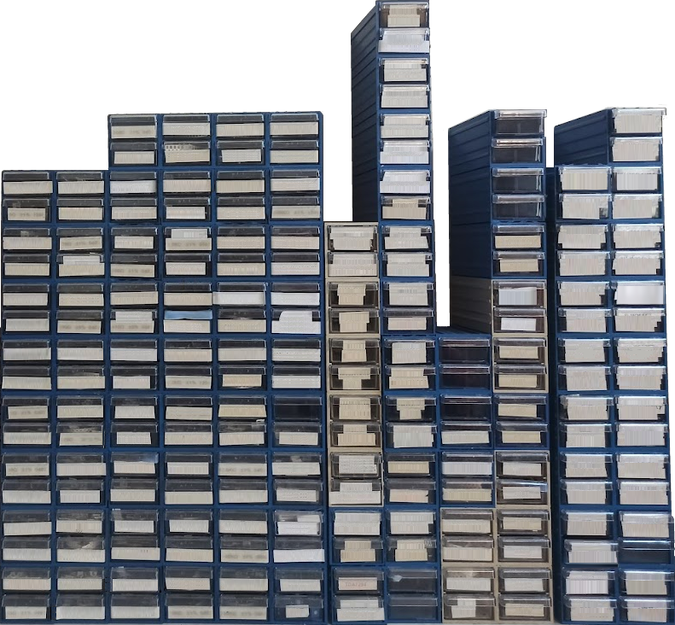
section
[Resistors]
section
[Regulators]
section
[Inductors]
section
[Transistors]

Slide 3
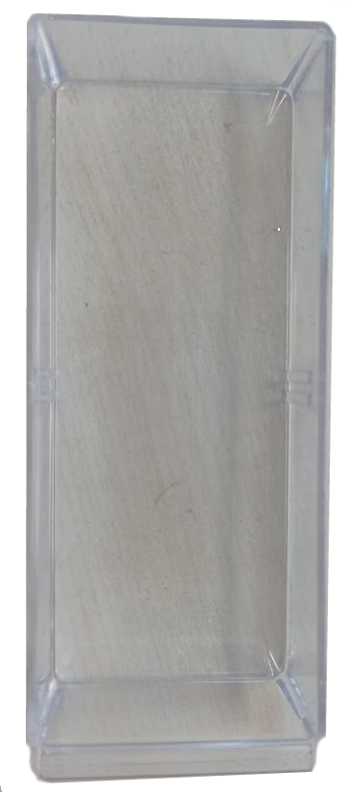
Subspace
Subspace

